Slide 1
MAS.s62 Cryptocurrency Engineering and Design
Final Project by Thalita Berpan & Bernard Snowden
Kalpa: Design and implementation of ERC20 for gift card purchase, redemption & exchange

Slide 2
Motivation
Small merchants cannot effort a loyalty program …
because traditional loyalty programs are expensive (lack of time or resources). If they have a loyalty program, it is likely that they have to print out loyalty cards and paper receipts that customers would end up throw away anyway -- yet still, unable to attain repeat customers.
On the other hand, large corporations such as Starbucks can afford to build and maintain loyalty program driving significant growth, with over 36 percent of US revenue ($15b) coming from the Star program¹
Nearly $1 billion in gift cards go unused each year²
CEB TowerGroup
see Starbucks rewards members can now earn even more stars at the grocery store

Slide 3
Overview
Project goal: To build gift card tokens and exchange leveraging techniques from the course
Process overview:
Explore and evaluate appropriate techniques/platforms for the project e.g ERC20 (Ethereum Request for Comments 20), Lightning, custom blockchain
Decided on design and implementation on ERC20
Design base system architecture
Set up ERC20 development blockchain
Implement our base system architecture

Slide 4
Design: store/customer journey
Store journey
Register: create tokens (new store account)
Sell coin: receiving fiat in exchange for tokens
Redemption: receiving tokens in exchange for goods/services
Key: system needs to be able to verify that tokens are not double spent; ERC20 guarantees this
Customer journey
Register: create a wallet (Kalpa account)
Buy coin: giving fiat in exchange for tokens
Redemption: giving tokens in exchange for goods/services
Key: system needs to be able to let users exchange tokens with stores and among each other

Slide 5

Design: structure of the base system
3 main functions
Create a store initialized with a token
Exchange of tokens between addresses
Inventory management and item purchasing

Slide 6
Demo

Slide 7
Key learning
Smart contract set up, design and development flow
High return (risks) for thoughtful system architecture given future changes are limited once the system is live
Testing is crucial, given no or little rooms for errors
Decentralized protocol could work for this application
The viability of the solution is contingent on the economics (e.g. transaction fees, duration) and usability (e.g. interface, flexibility)

Slide 8
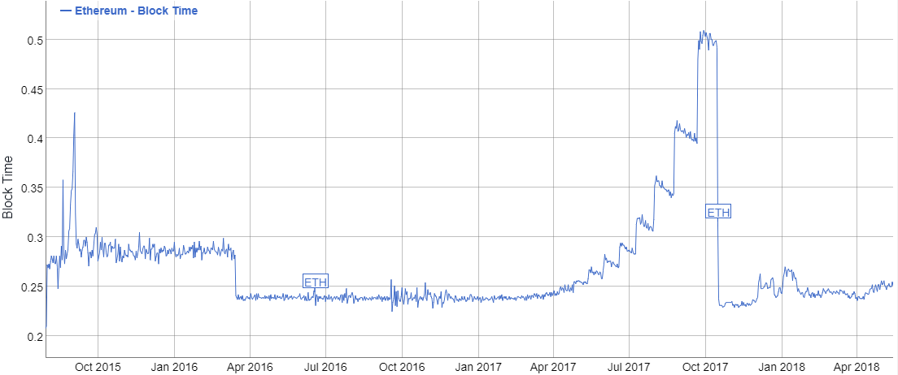
Historical Ethereum Block Time
Average block time (minutes)
https://bitinfocharts.com/comparison/ethereum-confirmationtime.html

Slide 9
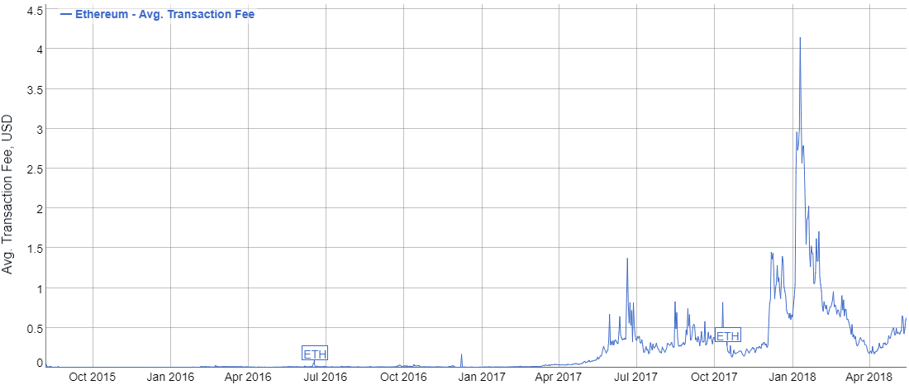
Historical Ethereum Avg. Transaction Fee
Average transaction fee, USD
https://bitinfocharts.com/comparison/ethereum-transactionfees.html

Slide 10
Appendix

Slide 11
Operations
//create Contract
var contract = DefaultGiftToken.at(DefaultGiftToken.address) //create address
contract.createStore("WAL","Walmart")
//Initialize merchant address with tokens
contract.mint(0xd9aB855A35758d989c711B4f1c0DB6d7fF9f5871, 10000);
//Ask to see what the balance is
contract.queryBalance(0xd9aB855A35758d989c711B4f1c0DB6d7fF9f5871)
contract.sendToken(0xd9aB855A35758d989c711B4f1c0DB6d7fF9f5871, 0x705B40Df7042a3F99a2815298C89665C9BE3d54f, 500)
contract.queryBalance(0x705B40Df7042a3F99a2815298C89665C9BE3d54f)
contract.addItemsToStore('twix', 15, 1)
// add twix bars to Walmart inventory
contract.purchaseItem('twix', 10, 0x705B40Df7042a3F99a2815298C89665C9BE3d54f, 0xd9aB855A35758d989c711B4f1c0DB6d7fF9f5871)
contract.queryBalance(0x705B40Df7042a3F99a2815298C89665C9BE3d54f)

Slide 12
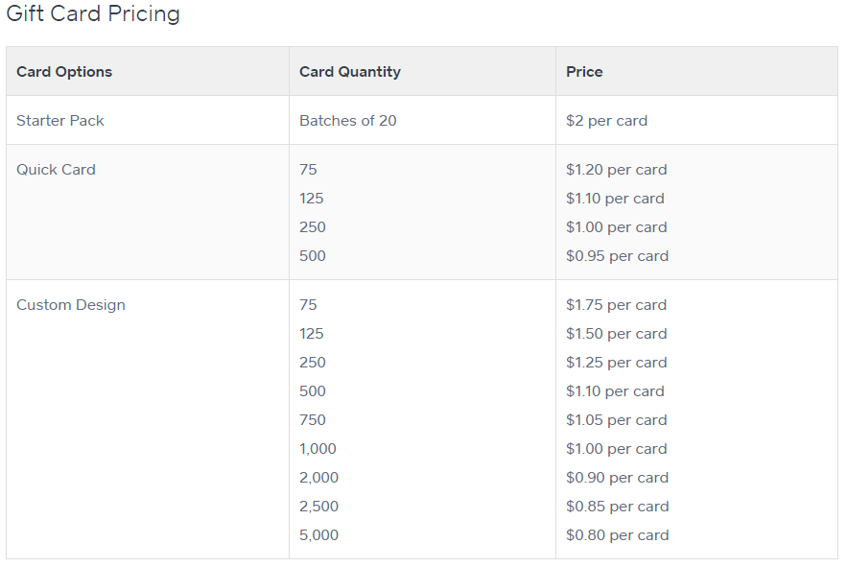
Squareup Gift Card Pricing
https://squareup.com/help/us/en/article/5393-order-your-square-gift-cards

Slide 13
Ethereum Tokens Market Capitalization: https://etherscan.io/tokens

